Slide 1
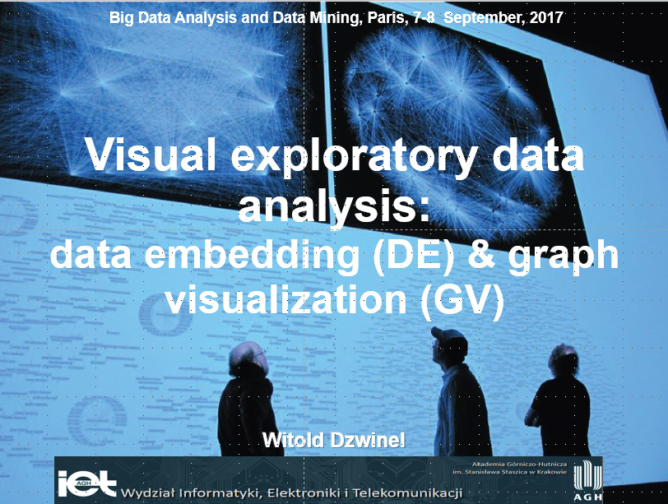

Slide 2
Organizacja zajęć
1. Wykład sobota (4 godziny) – „Wizualizacja wielo-wymiarowych zbiorów danych”.
2. Ćwiczenia niedziela (4 godziny) – wizualizacja małych zbiorów danych (Orange, soft).
3. Ćwiczenia sobota (4 godziny) Wizualizacja dużych zbiorów danych i grafów (ivta, Gephi, ivga).
4. Projekty samodzielne (Orange, Gephi)
Linki: https://gephi.org/users/download/, https://orange.biolab.si/download/windows/
Ivta, ivga, dane → Moodle

Slide 3
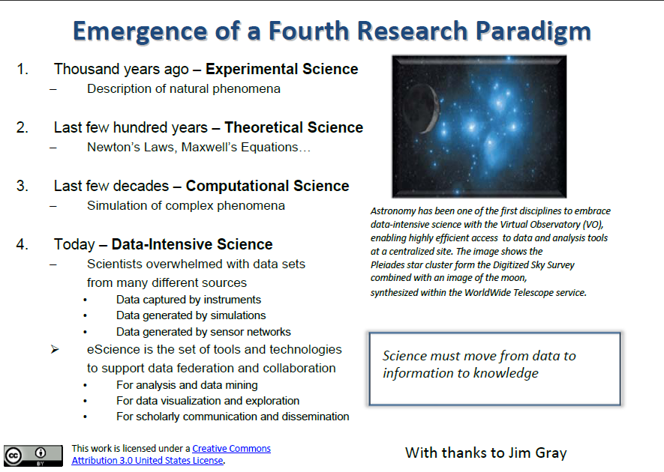

Slide 4
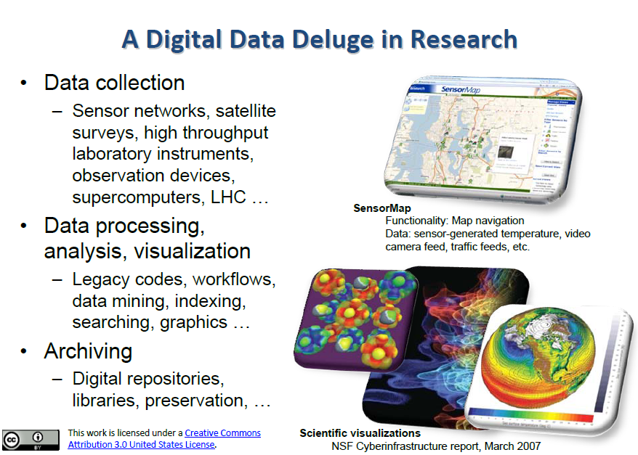

Slide 5
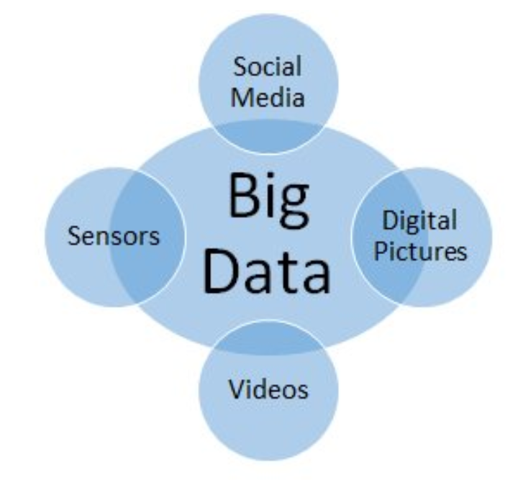
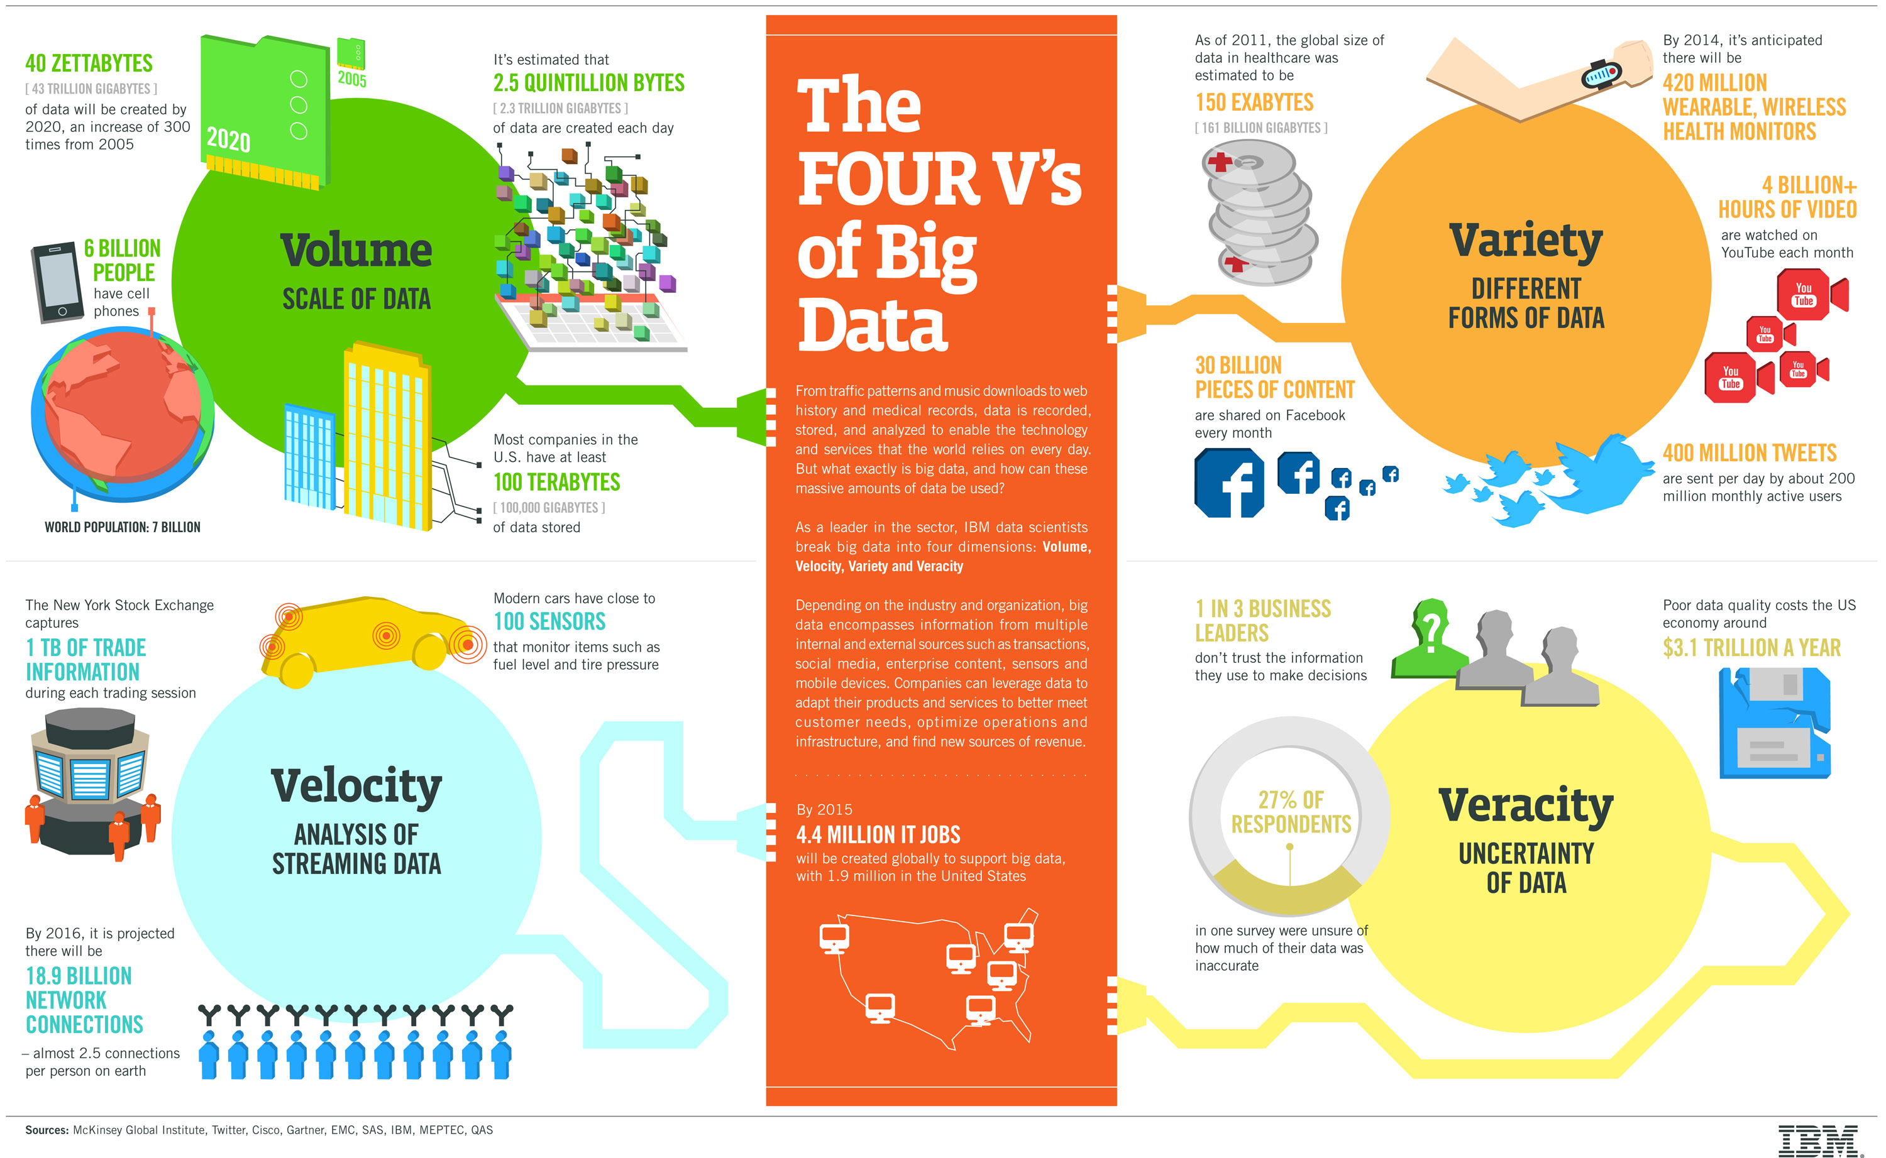
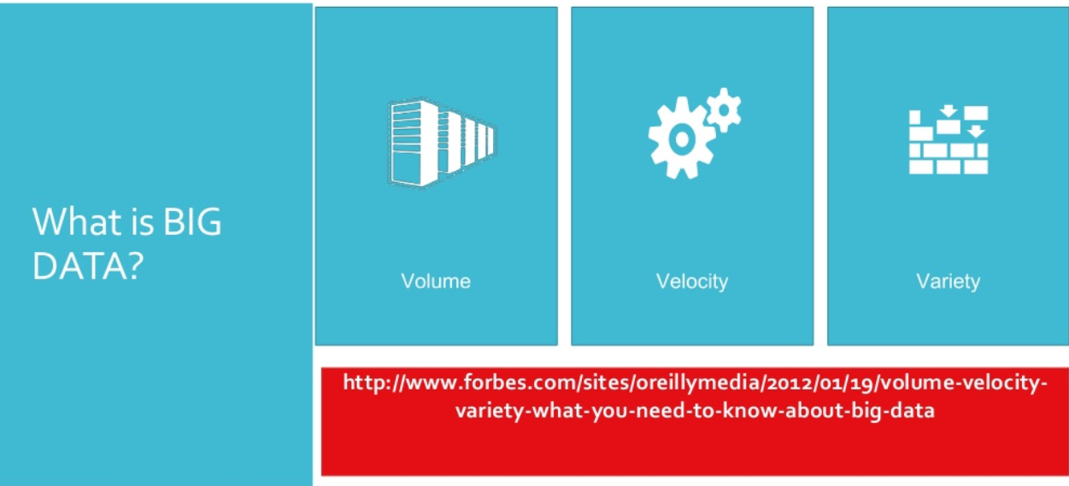
Big data

Slide 6
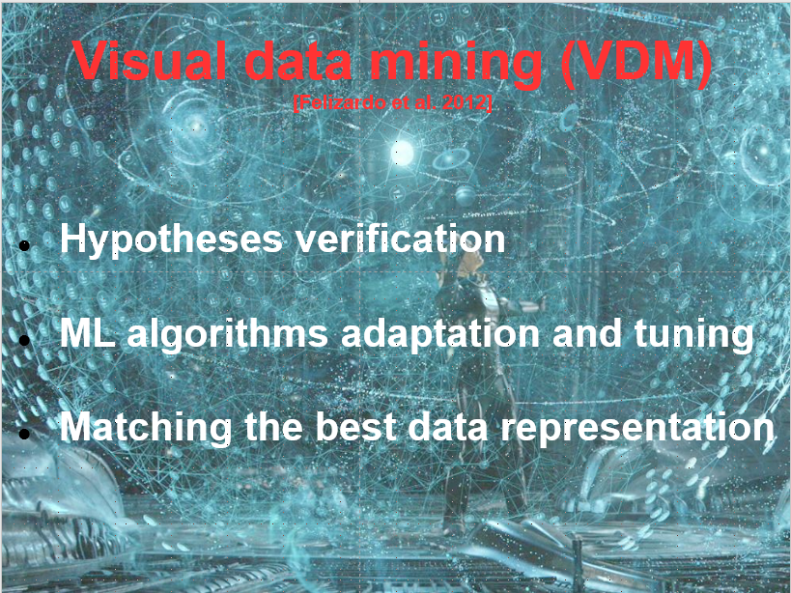

Slide 7
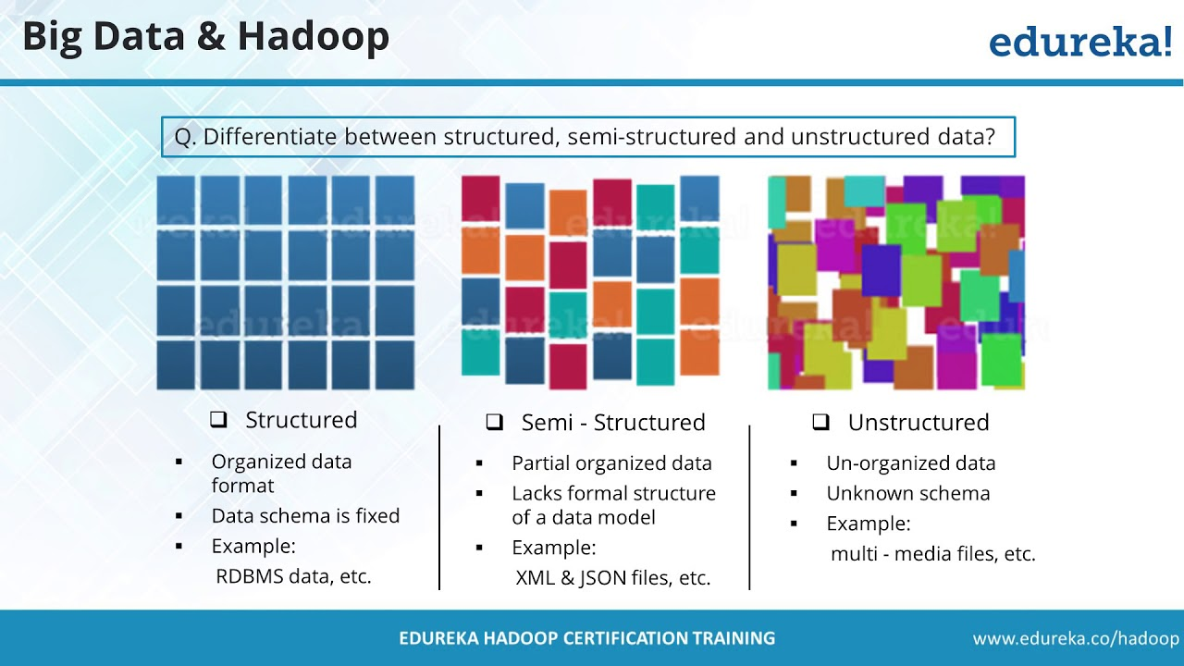
Data types

Slide 8
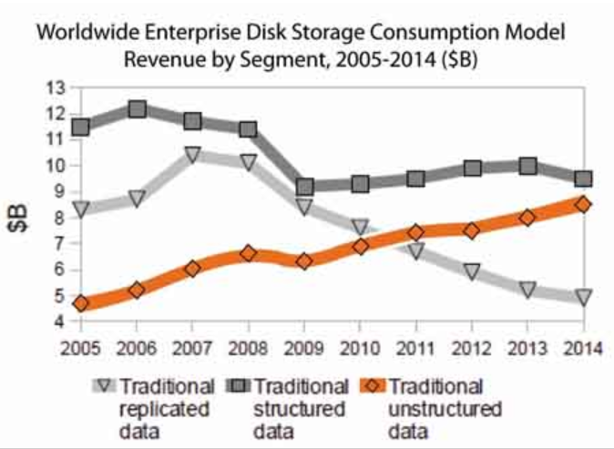
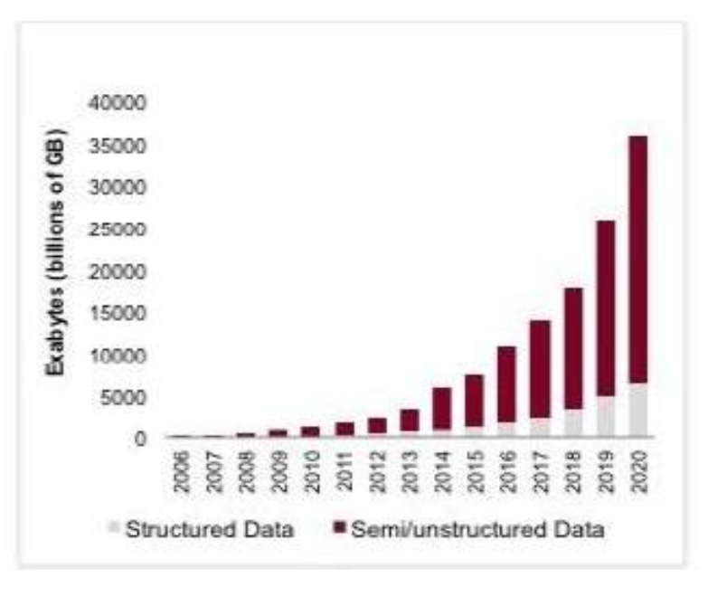

Slide 9
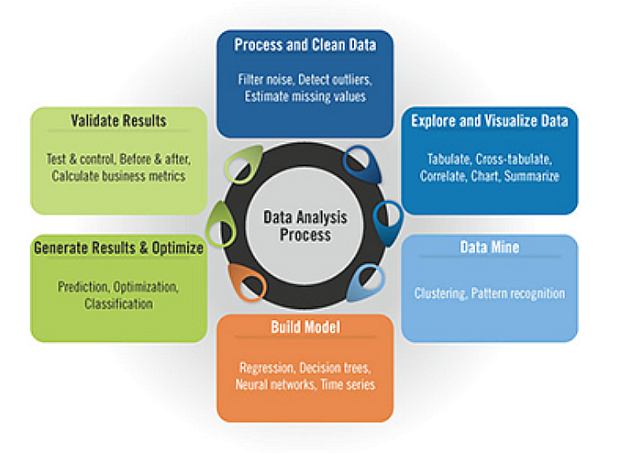
Data analytics

Slide 10
Visualization
How to represent various type of data?
Structured - multidimensional
Unstructured (text)
Heterogeneous
Data streams
How to visualize big data?
Multi-scale visualization
Interactive visualization
Context visualization

Slide 11
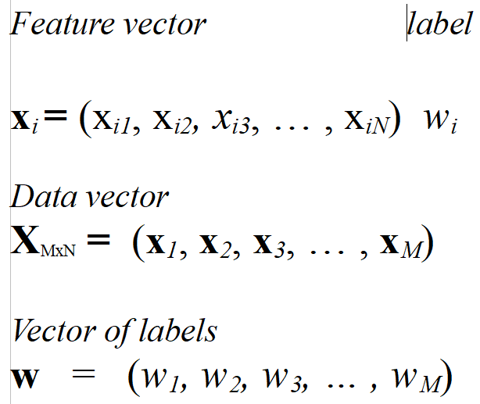
Vectors→data representation

Slide 12
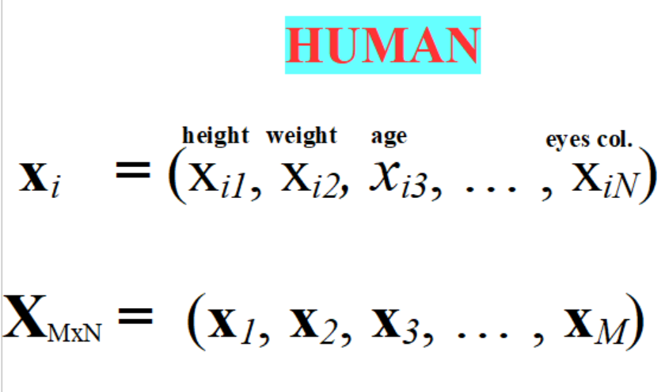
Vectors→data representation

Slide 13
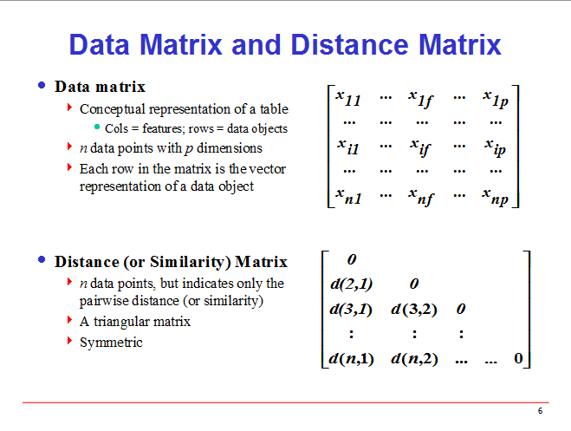
Notes:
13

Slide 14
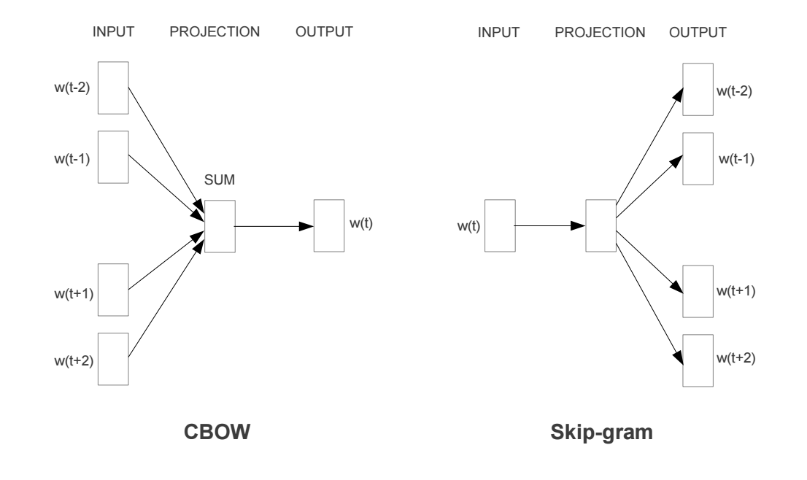
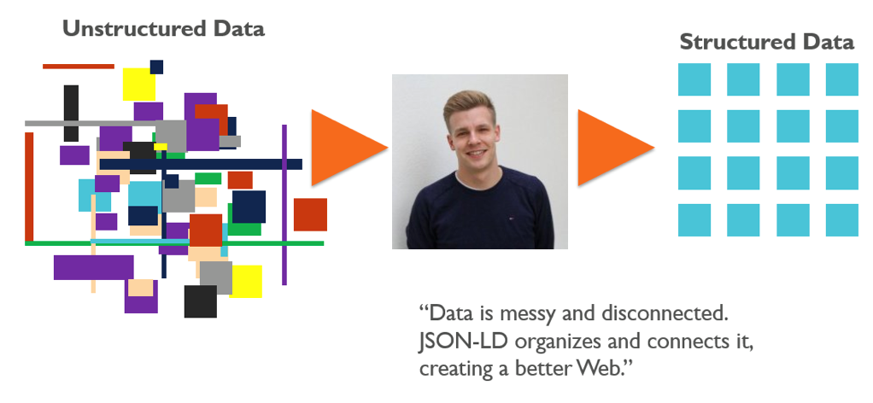
Data embedding

Slide 15
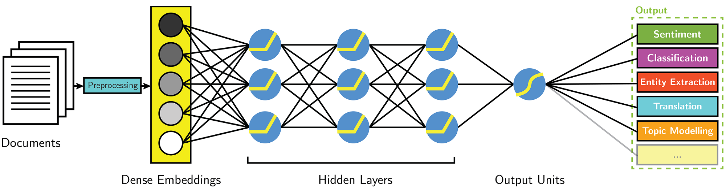
Embedding and processing

Slide 16
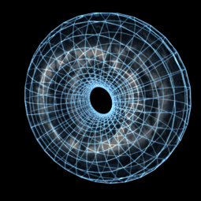
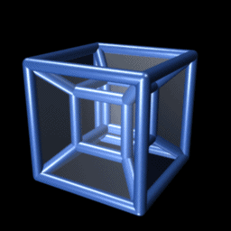
Multi-dimensional space

Slide 17
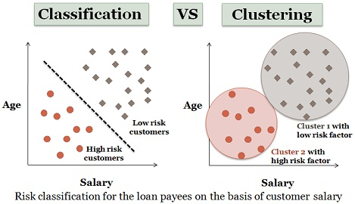
What are we looking for?

Slide 18
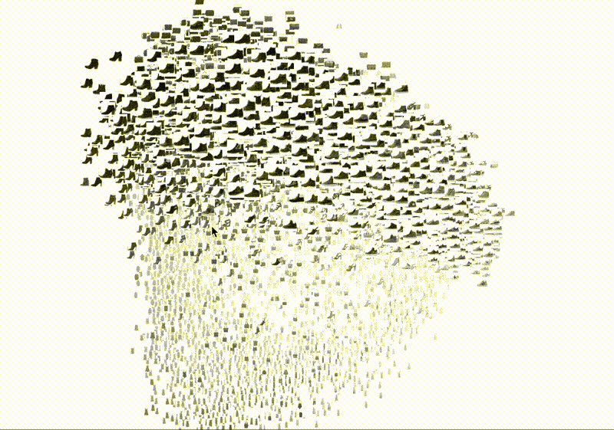
Classes recognition

Slide 19
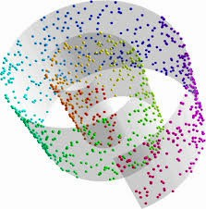
Data seem to be messy

Slide 20
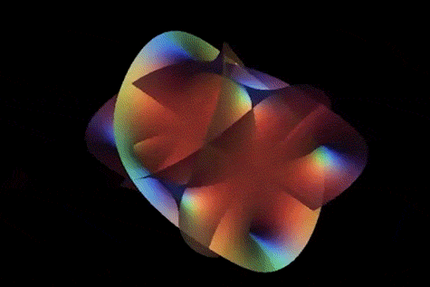
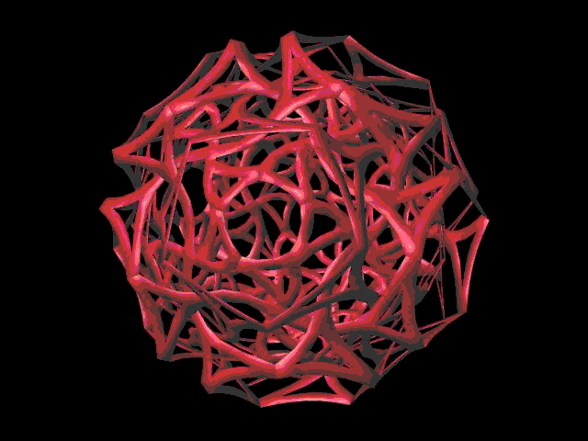
Manifold detection

Slide 21
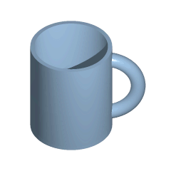
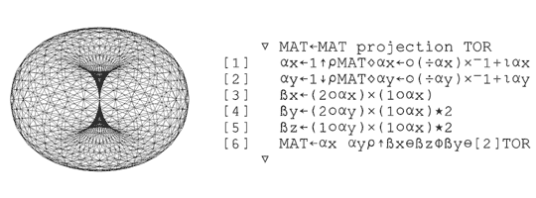
Manifold unfolding

Slide 22
Multidimensional data
visualization

Slide 23
Notes:
23

Slide 24
Multi-dimensional data visualization
Three common ways to visualize multi-dimensional data:
Parallel Coordinates
Star glyph plots
Scatter-plot Matrix

Slide 25
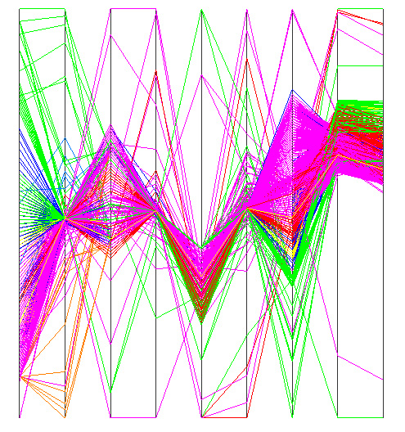
Parallel Coordinates
In Parallel Coordinates, each dimension is denoted by a vertical axis.
Each object is represented as a poly-line. The y-coordinate of the poly-line on axis-i is its normalized value in dimension d_{i}.

Slide 26
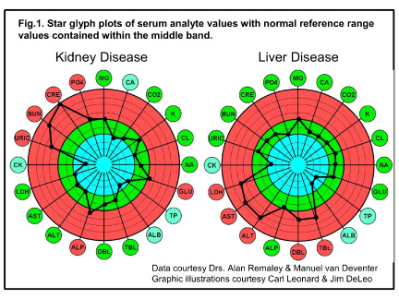
Star glyph plots

Slide 27
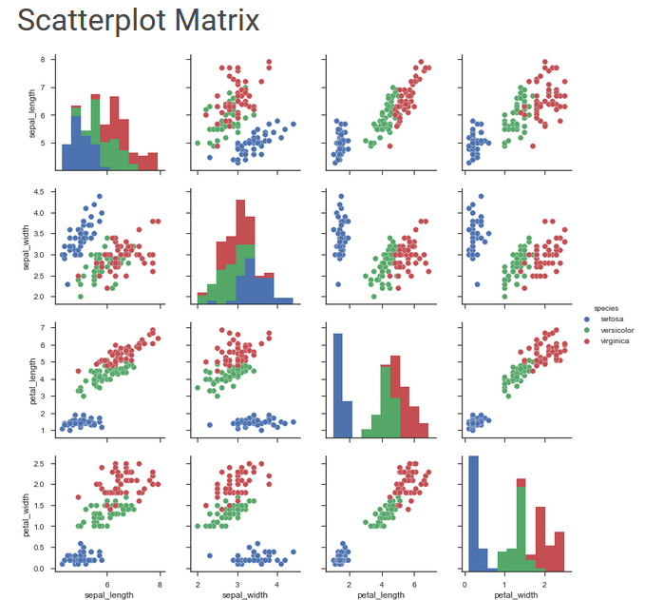
Scatter-Plot Matrix

Slide 28
Multidimensional data visualization – larger data
PCA
Classical MDS
Inne
Isomap (manifold distances)
Sammon and Niemann MDS (stress function)
Landmark and Pivot MDS
LLE (locally linear embedding)
t-SNE

Slide 29
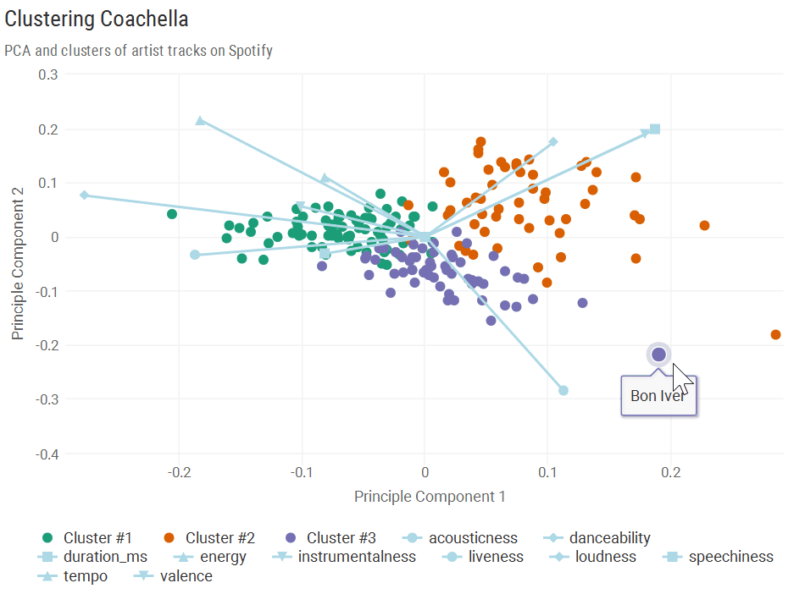
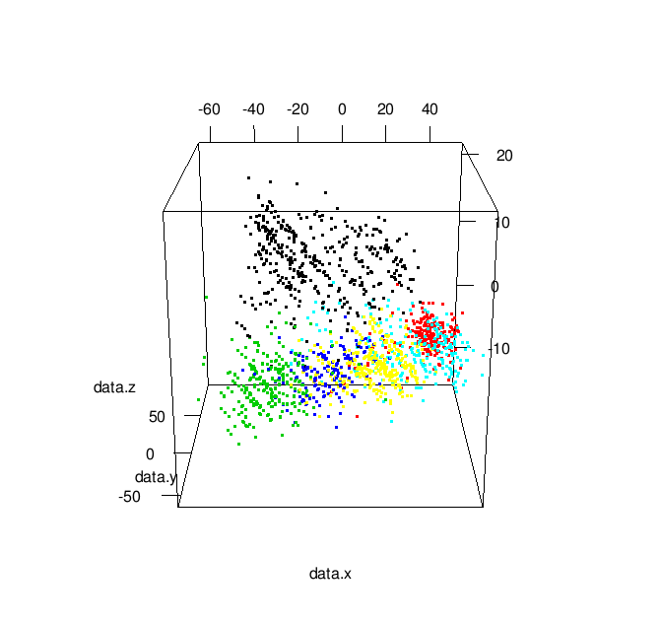
Principal Component Analysis

Slide 30

K-L - Algorithm
X={x₁,…,x_{M}} x_{k}={x_{k,1},…,x_{k,N}}
Compute covariance matrix R_{i,j}=E(x_{i},x_{j}} (NxN)
Solve Rv=lambdav, find the largest lambda_{i} and corresponding v_{i} {i=1,…,m}
Transformation matrix A ={v₁,…,v_{n}}
y_{i}= Ax_{i}, i=1,…,N
visualize y_{i}
Witold Dzwinel
30
Notes:
30
w

Slide 31
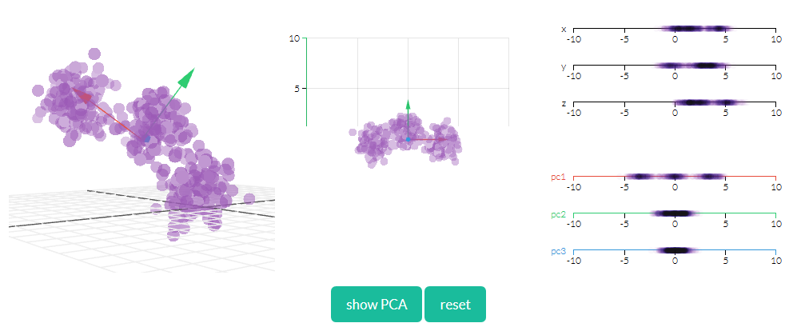
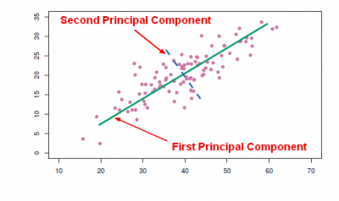
K-L - Algorithm

Slide 32
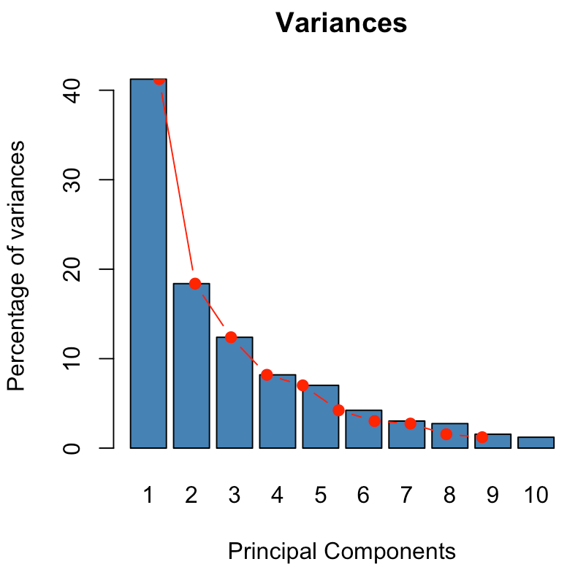
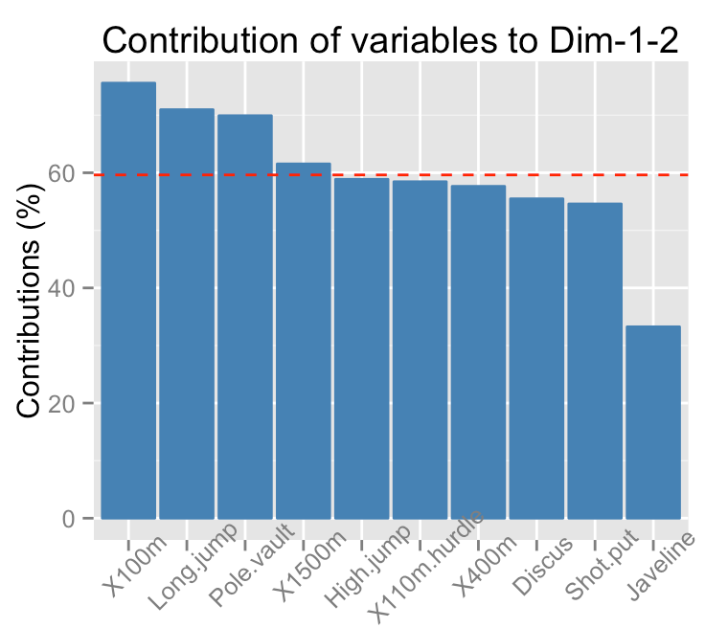
Eigenvalues → contribution

Slide 33
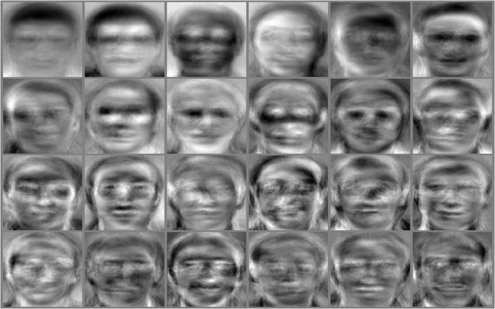
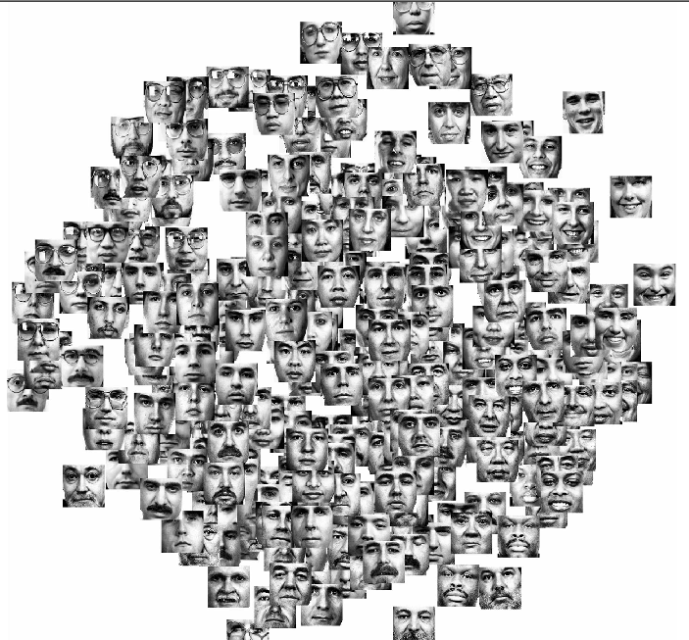
Witold Dzwinel
33
Notes:
33

Slide 34
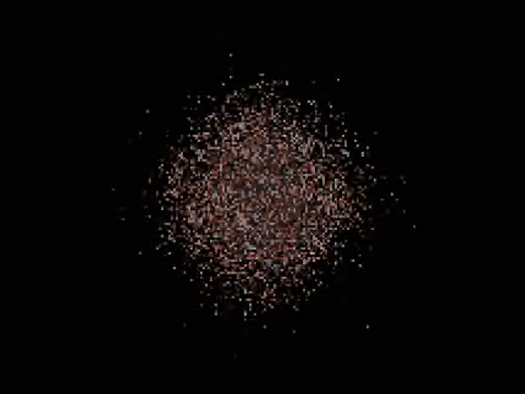
Notes:
34

Slide 35
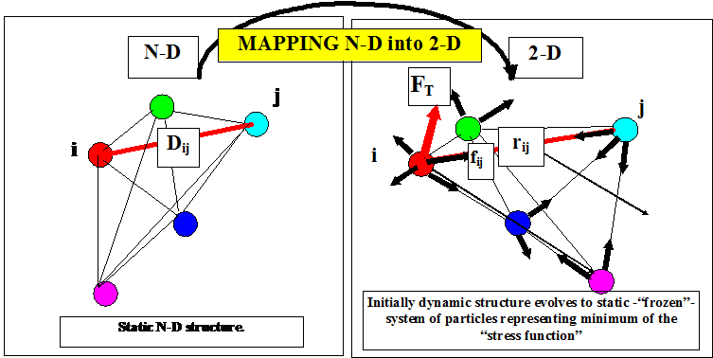
Multidimensional scaling
Dzwinel W, Blasiak J, Future Generation Computers Systems, 15, 365-379, 1999

Slide 36
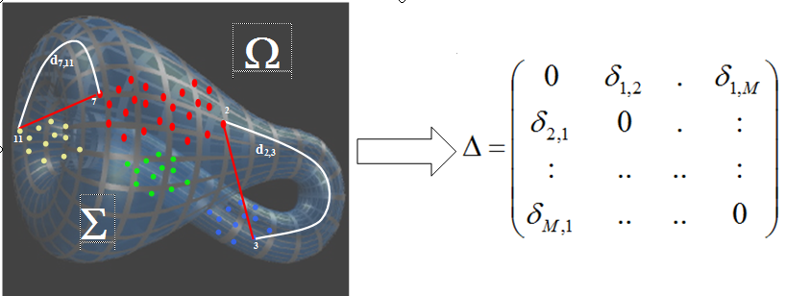
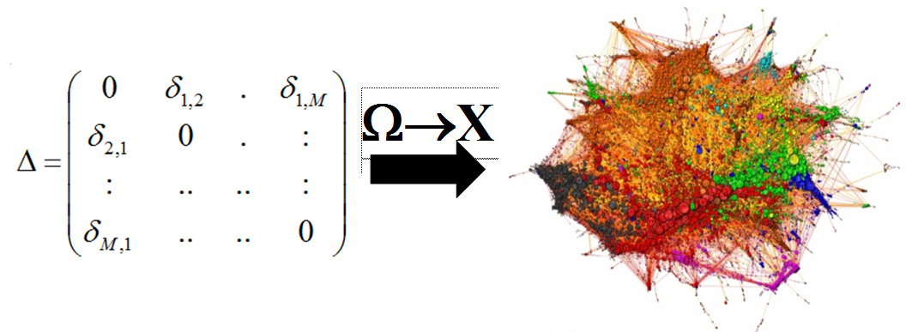
Ω→X mapping
Dzwinel,W, Yuen, D.A., Boryczko, K., Ben-Zion, Y., Yoshioka, S., Ito, T., Nonlinear Processes in Geophysics, 12, 117-128, 2005

Slide 37
Kruskal MDS and NLM
Kruskal – classic MDS
metric MDS – gradient method
2. non-metric MDS – increasing order sorted list of distances between all points pairs – position on the list → terminal distances
3. Sammon non-linear mapping (NLM)
Notes:
37

Slide 38
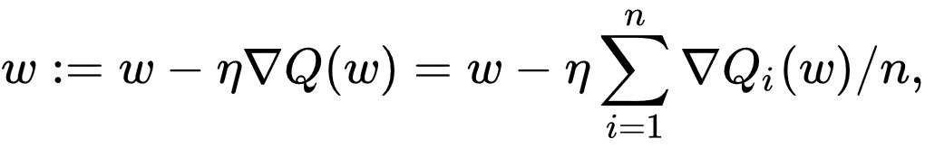
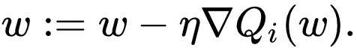
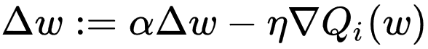
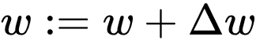
Minimization of stress function
Gradient descent
Stochastic gradient descent
Momentum method
Nestorov gradient descent, ADAM, AdaGrad, RMSProp

Slide 39
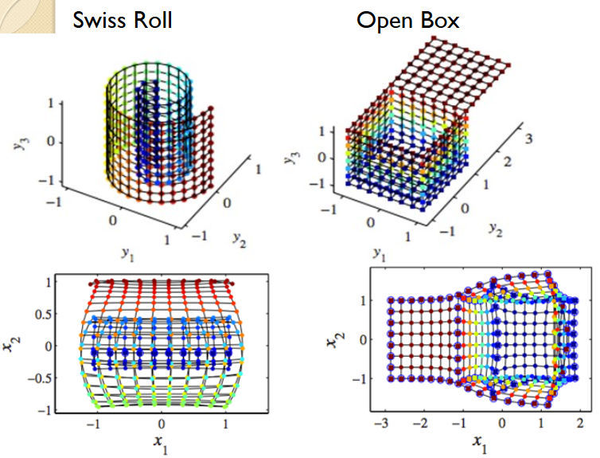
MDS

Slide 40
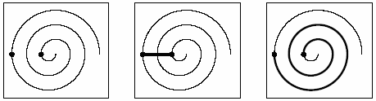
CDA (Curvilinear Distance Analysis)
Improved CCA
Curvilinear distances are computed on the manifold
Every point is connected to k nearest neighbors (Euclidean distance between nodes)
Notes:
40

Slide 41
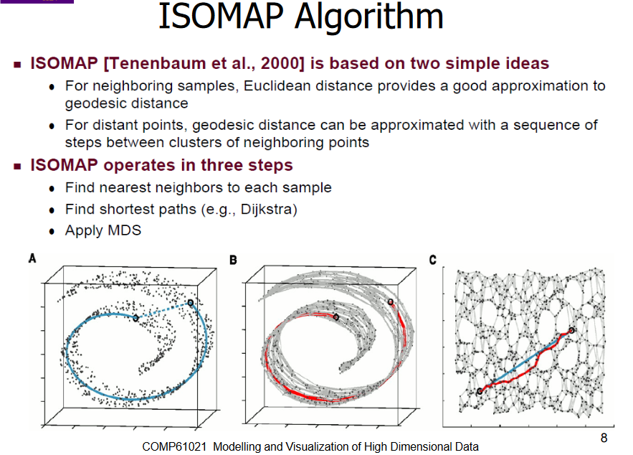

Slide 42
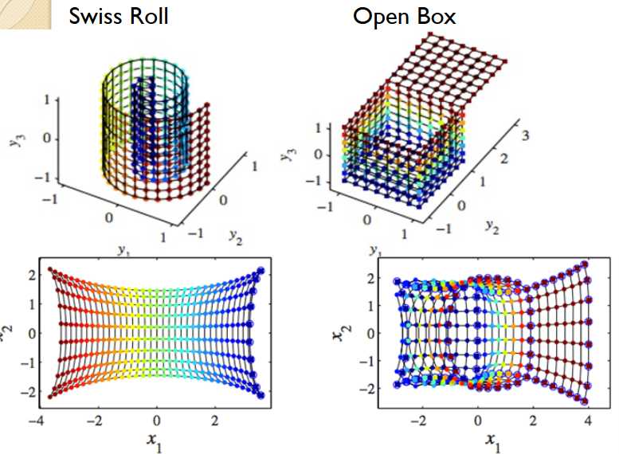
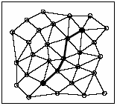
CDA(2)
Curvilinear distance between points is equal to the length of the shortest path between these points
Notes:
42

Slide 43
LLE (Locally Linear Embedding)
Every vector is a linear combinantion of its k-NNs.
Minimization of the following error criterion
X_{i} – wektory w przestrzeni oryginalnej
W – szukana macierz wag
Additional conditions applied:
W_{ij} = 0 when X_{j} is not in kNN list of X_{i}
sum of rows in W is normalized to 1
Notes:
43

Slide 44

LLE (2)
This is a single solution problem which can be solved analytically.
Owing to W, Y_{i} can be find by minimization of the following criterion:
Additional conditions should be applied:
Σ_{i}Y_{i} = 0
Σ_{i}Y_{i}Y_{i}^{T} = nI , n → number of vectors,
Notes:
44

Slide 45

LLE

Slide 46


Slide 47

Validation - descriptors
trustworthiness and continuity
trustworthiness – k-NN in target space are also its k-NN in source space
continuity – k-NN in source space are also its k-NN in target space
Shepard diagram (diagram „dy – dx”)
Notes:
47
Pewność ciągłość

Slide 48


Slide 49

Examples
Arodz, Boryczko, Dzwinel, Kurdziel, Yuen: IEEE Visualization 2005: 90

Slide 50

Robustness of MDS

Slide 51
Reduced MDS on GPU
Landmarks
Subsets

Slide 52

MDS → reduced dissimilarity array
MDS →random distances selection

Slide 53

Exploring LargeData
visually
Vector embedding (VE)
Graph visualization (GV)
Witold Dzwinel
Ottawa, 29 July 2015

Slide 54
Vector embedding (VE) problems
1. Curse of dimensionality dim Ω =N>>100
(Euclidean distances between N-D data → the same)
2. Complex manifold structure
3. O(M²) memory& O(MlogM) computational complexity
4. Multidimensional&multimodal optimization problem
Solution: Radical decrease of complexity of data embedding to O(M)

Slide 55


Curse of dimensionality
ALL distances
3-NN distances

Slide 56
State of the art → VE
Novel minimization criterion
t-SNE [Van der Maaten and Hinton, 2011], ws-SNE [Yang et al., 2015]
Not all distances computed
BH-SNE [Van der Maaten, 2014]: O(NlogN) SUBSET [Pawliczek, Dzwinel, 2034] O(N)
Approximate NN computation
Q-SNE [Ingramand Munzner, 2015]
Force-directed method for “stress” optimization
PM, FDM [Dzwinel and Błasiak, 1999; Andrecut, 2009]
f_{ij} = K * (D_{ij}^{k} – d_{ij}^{k})^{m} *r_{ij}

Slide 57
Novel minimization criterion – divergence
Stochastic Neighbor Embedding
t-Distributed Stochastic Neighbor Embedding
Symmetric SNE
Mismatched Tail can Compensate for Mismatched Dimensionalities

Slide 58







Stochastic Neighbor Embedding
Data space
Map space
Cost function
Perplexity
Gradient descent method
58

Slide 59





Symmetric SNE (t-SNE)
To use Student-t distribution improve performance.
Cost function is difficult to optimize ⬅ Symmetrized
Crowding problem ⬅ heavy-tailed distribution
Cost function
Map space
Data space
Gradient descent method
59

Slide 60



Mismatched Tails can Compensate for Mismatched Dimensionalities (t-SNE)
Map space
Gradient descent method
60

Slide 61

Experiments https://distill.pub/2016/misread-tsne/
Data Sets
MNIST data set, Olivetti faces data set,
Experimental Setup
To use PCA to reduce the dimensionality
Cost function parameter settings
61
Notes:
61

Slide 62




Visualizations of 6,000 handwritten digits from the MNIST data set
Sammon mapping
t-SNE
Isomap
LLE
62

Slide 63

Visualizations of the Olivetti faces data set
t-SNE
Sammon mapping
Isomap
LLE
63

Slide 64


Not all distances computed
Selected distances
Landmark/SUBSET
Barnes-Hut tree
bh-sne, q-sne, ws-sne

Slide 65


Approximate NN search (Q-SNE)

Slide 66

Graphs visualization

Slide 67


PCA based of ultra-fast method of graph embedding Harel, Koren, 2004

Slide 68

PCA based of ultra-fast method of graph embedding

Slide 69



Ultra fast method of graph embedding

Slide 70




K-NN graph visualization

Slide 71



Force directed method

Slide 72

State of the art → GV
1. Force directed method (spring-electrical)
Fruchterman and Reigold [1991]
2. Not all distances computed
Burnes-Hut approximation: [Y.Hu, 2006]
3. Big GV millions of nodes and edges
The University of Florida Sparse Matrix Collection
https://www.cise.ufl.edu/research/sparse/matrices/

Slide 73
O(M²) memory& O(MlogM) computational complexity do not allow for using VE for BIG DATA visualization
Solution:
Radical decrease of complexity of data embedding to O(M)

Slide 74

Concept
VE and GV methods are strongly overdetermined. In n-D only:
distances define the stable solution
Which distances?????

Slide 75



A few NN and a few RN
N-D
ALL distances
2-D
3-NN
1-RN
3-NN

Slide 76



Concept
1. ∀i, find n-NN_{i} and r-RN_{i} (which are not n-NN)
2. Use force directed method
n indices of n-NN_{i} (n=2,3 for 2-D embeddings)
r indices to r-RN_{i} (r = 1)

Slide 77


Binary vs. Euclidean
NN in 2-D
all in 2-D

Slide 78

Proof of concept

Slide 79




MNIST
a
3 h
b
c
12 s
a) DBN (M=7000) b) BH-SNE (M=70000) [Van Maaten, 2014] c) nr-MDS (M=70000)

Slide 80

NORB (small)
M=43600, N=2048
The NORB dataset (NYU Object Recognition Benchmark) contains stereo image pairs of 50 uniform-colored toys under 18 azimuths, 9 elevations, and 6 lighting conditions

Slide 81

DBN - autoencoder
[Snoek et al., 2012]

Slide 82



Autoencoder, Snoek et al.2012
NORB: 1m
Van der Maaten, 2014

Slide 83

Reuters
5 min

Slide 84



20NG
ws-SNE, Yang et al. 2014

Slide 85

Crowding effect

Slide 86



Graph visualization perspective
20NG - VE

Slide 87

20NG - DE
20NG - GV

Slide 88

Big graphs (social networks)

Slide 89

State_of_the_art
2167.88 sec.
250 sec.
http://yifanhu.net/index.html
AT&T Labs -- Research

Slide 90


Slide 91


Slide 92


Slide 93

Big graphs (road network)

Slide 94

Pennsylvania road network

Slide 95



13 min 20 sec

Slide 96

http://yifanhu.net/index.html
AT&T Labs -- Research

Slide 97

Big data perspective

Slide 98
Conclusions
1. Low memory complexity O(nM)
2. Small computational complexity O((n+r)M)
3. High level of parallelization (PM)
4. Easy implementation on Big data platforms (Hadoop, Apache Spark)
5. Near neighbors (NeN) instead of NN!
6. Big graphs visualization

